Slide 1
Sharing on Project Lessons Learnt (PLL) conducted in PRPC for FY2016
Presentation by:
Reza Ikram A Rani
Profiling & Assurance (Project)
Internal

Slide 2
Why do we need to conduct Project Lessons Learnt?
BACKGROUND
To gather any lessons learnt during the project that can be usefully applied to other projects
To capture the knowledge before the team disbands and secure the lessons learnt for the benefit of future project and future assessment
Improved knowledge to make better decision
Internal

Slide 3
The PLL workshop shall be structured as to gain the most out of the participants. As a guide, the session should proceed and take heed of the following categories
METHODOLOGY
Views about past experience are drawn from workshop participants, then grouped into the appropriate *categories which include the following;
Engineering
Procurement
Construction
Project Management
Interface
Contract
Commissioning
QA/QC
HSSE
Document Management
*The list is not exhaustive
Source:
PETRONAS Project Management System (PPMS 2009), Risk Management Manual
Internal

Slide 4
The causes or impacts of each issue is to be defined, and the issue will be ranked as high, medium or low based on the impact assessment / consequences
METHODOLOGY
Lesson Description
Cause
Impact / Consequence
Action Taken / Recommendation
Impact Level
Source:
PETRONAS Project Management System (PPMS 2009), Risk Management Manual
Internal

Slide 5
FRAMEWORK
PIC Portfolio PRM Framework dictates the requirement of PLL which is identified at each phase of the project life cycle and at a predetermined frequency to capture lessons from project in progress up to the acceptance of the project.
“Doing the Right Project”
“Doing the Project Right”
FRONT-END LOADING (FEL)
START-UP
OPERATION
PHASE
FRAMING
FEL 1
Feasibility
FEL 2
Scope Selection
FEL 3
Scope Definition
EXECUTION
Gate 0
Gate 1
Gate 2
Gate 3
Gate 4
FID
Engineering & Procurement
QUALITATIVE
PRA
Construction
Commissioning
Prior to SG1
Prior to SG2
Prior to SG3
QUANTITATIVE
SRA
CRA
Pre-FID
20% to 30% of total execution progress
PIR
25% Construction
Conceptual
Design
FEED /
Basic Design
Prior to ITB
15% Construction
Pre Start-Up
Mandatory
Optional
Construction
PLL
50% Procurement
Post Engineering
Refer PLL
Refer PLL
Refer PLL
PLL Workshop
End of Execution Phase
PLL
Database
Source:
PETRONAS Project Management System (PPMS 2009), Risk Management Manual
This slide was approved during 10 June 2015 Project Risk Management Working Committee (PRMWC)
Internal

Slide 6
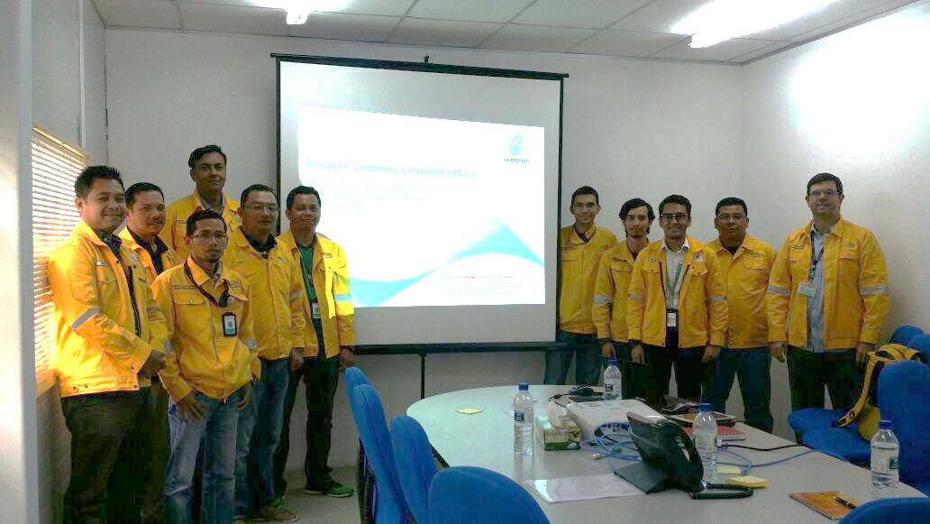
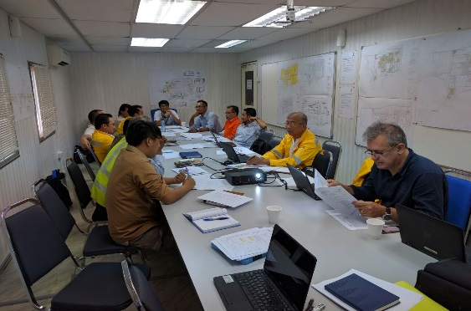

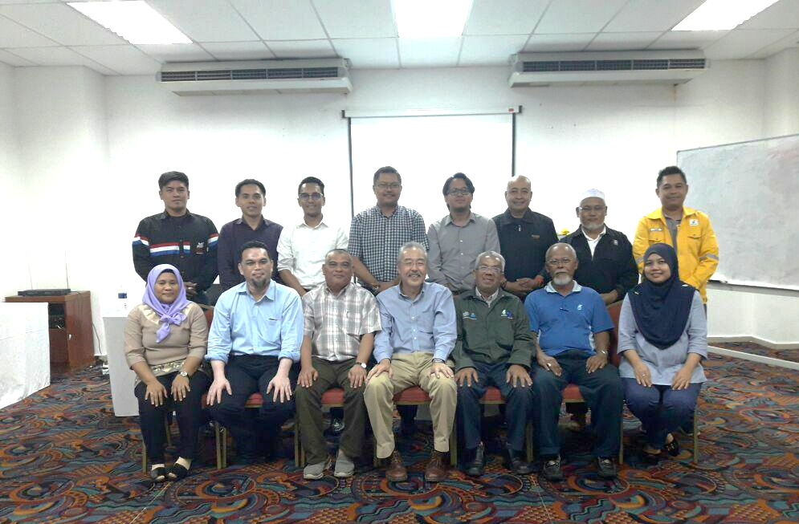
6 Project Lessons Learnt workshops were successfully conducted in FY2016…
TIMELINE
PACKAGE
Refinery & Cracker
PACKAGE 2
20C2
Engineering & Procurement
22 November 2016
Refinery & Cracker
Close-Out
28 January 2016
PACKAGE 3
Engineering & Procurement
6 October 2016
Gas & Power
RGT-2
Engineering
1 May 2016
PLL RC P3
JAN | FEB | MAR | APR | MAY | JUN | JUL | AUG | SEP | OCT | NOV | DEC
Refinery & Cracker
PLL AWARENESS
8 September 2016
Refinery & Cracker
EURO 5
Prior FID (FEL)
25 November 2016
PACKAGE
PAMER
Close-Out
26 May 2016
Close-Out
19 December 2016
PLL P18A & 18B
Internal

Slide 7
…where 132 Lessons Learnt were identified mostly covering these 5 categories
FRAMEWORK
6
Project Lessons Learnt activities
132
Project Lessons Learnt identified
41
Engineering
19
Project Management
13
Procurement
12
HSES
8
Document Management
Internal

Slide 8



Engineering Lessons Learnt is recorded the highest in the PLL past year (FY2016)
ENGINEERING
41
FY2016
Engineering
Project Lessons Learnt
Common PLL identified in PRPC Projects
Delays in Change Order Approval
Unfamiliarity of PTS requirements and project specification by EPCC/Vendor
Late mobilization of iPMT to home office
Interdisciplinary design changes not properly escalated / communicated amongst EPCC/PMT
Failure to timely acquire plot plan
Lack of communication between PRPC Core Engineering, LICENSOR and FEED team
Internal

Slide 9


Project Mgmt. Lessons Learnt is recorded the 2nd highest due to challenges dealing in integrated project
PROJ. MGMT.
19
FY2016
Project Mgmt.
Project Lessons Learnt
Common PLL identified in PRPC Projects
Untimely mobilization of sufficient workforce to Home Office / Site
Challenges in doing project in fast track environment
Proper platform for grievance management for workers
Internal

Slide 10




Procurement & HSES are also amongst the most common Lessons Leant identified for PIC projects
PROC. & HSES
13
FY2016
Procurement
Project Lessons Learnt
Delay in delivery of critical equipment & materials due to the enforcement of CIDB/COA
Unfamiliarity of PETRONAS requirements by EPCC/Vendor
Common PLL identified in PRPC Projects
12
FY2016
HSES
Project Lessons Learnt
Non-compliance with confined space and scaffolding activities
Common PLL identified in PRPC Projects
High turnover of Safety Manager at EPCC level
Internal

Slide 11
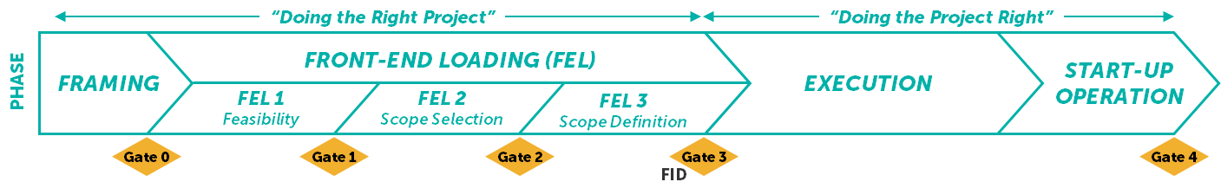
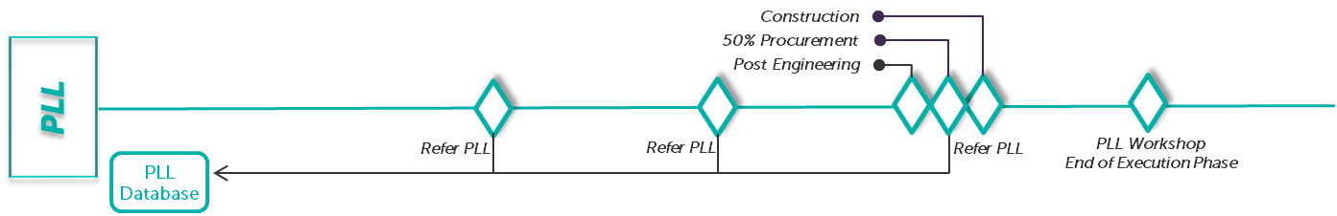
Lessons learnt for each phase of project implementation including the project closeout has been captured in a structured centralized database for any referencing by all project management team in PRPC
SYSTEM
Database
Active Risk Manager (ARM) system is developed for PRA and PLL management.
It is an online centralized database for real time sharing and learning to projects.
Internal

Slide 12
Challenges
CHALLENGES
Few challenges faced in conducting PLL in FY2016
Improvement
Disbandment of Project Team / Contractor prior PLL
Project team to conduct PLL before project close-out
Ensure continuity from FEL to Execution ; or
Ensure proper handover
Discontinuation of FEL team to Execution team
No proper platform for PLL to be documented
Establish centralized PRPC database for PLL
Internal

Slide 13
Project Lessons Learnt target to be conducted in Q1 FY2017
FY2017 Q1
Refinery & Cracker
PACKAGE 1
Refinery & Cracker
Engineering & Procurement
PACKAGE 5
Engineering & Procurement
Quarter 1
JAN 2017 | FEB 2017 | MAR 2017
Refinery & Cracker
PACKAGE 4
Engineering & Procurement
Petchem
C4 INA
Setapa / Ramunia
MOLF
Prior FID (FEL)
Close-Out
Internal

Slide 14
Way forward
WAY FORWARD
Further syndicate with GPD, PD&T to explore possibility of sharing PRPC PLL database for group-wide benefits.
E.g. :
Development of Share-point to be utilized by all PETRONAS project; or
Establishment of centralized database at PETRONAS level.
PRPC project team to incorporate its respective PLL planned activities for FY2017 and subsequently share the plan with PRPC Risk Management
Internal

Slide 15
Thank you
Internal

Slide 16
PLL Impact Level
Impact Level | Description
1 | Low priority action for improvement (Individual / Project Level)
2 | Medium priority action for improvement (Discipline / Functions / PMO Level)
3 | High priority action for improvement (Organizational Level)
Reference:PPMS_910-001_Project Risk Management Manual v1.0.doc
Internal

Slide 17
Next Action (PLL Deliverables)
1st draft of the PLL findings (in excel) will be shared to PMT 2 days after the workshop for review (3 working days)
The reviewed PLL to be submitted to PRPC Risk Management team for final report
PRPC Risk Management to generate PLL Management Report (5 working days after receiving it from PMT)
PLL Management Report is to be approved by Project/Package Manager
Approved PLL Report will be kept in PRPC centralized database for future reference
Internal

